Slide 1
Arduino WSN ZigBee
Gruppe 6 Pond Enviromental Meassurement Arduino WSN ZigBee

Slide 2
Arduino WSN ZigBee
Function Point Estimation
Defining the Unadjusted Function Point Count
Determining the Value Adjustment Factor
Determining Function Points

Slide 3
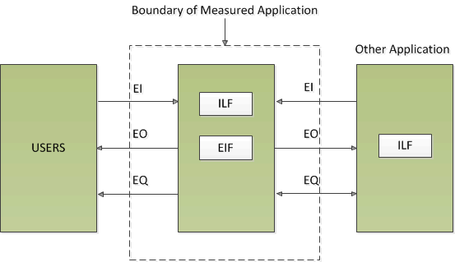
Arduino WSN ZigBee
1. Defining the Unadjusted Function Point Count
Figure 1

Slide 4
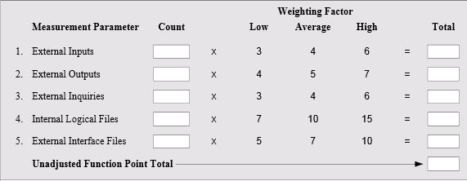
Arduino WSN ZigBee
Table 1 Unadjusted Function Point Count and Multipliers

Slide 5
Arduino WSN ZigBee
2. Determinig the Value Adjustment Factor

Slide 6
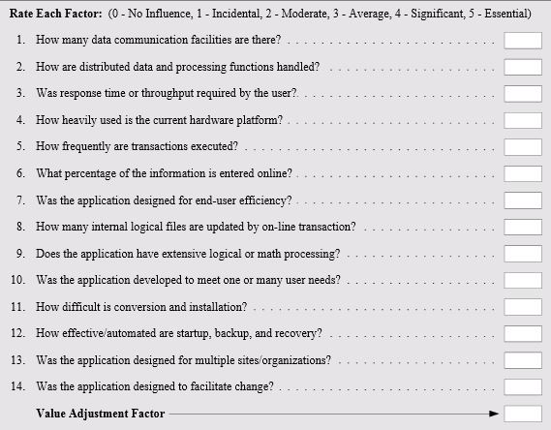
Arduino WSN ZigBee
Table 2 Total Degree of Influence

Slide 7
Arduino WSN ZigBee
3. Determining Function Points

Slide 8
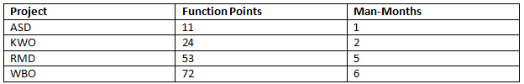
Arduino WSN ZigBee
Chart 1

Slide 9
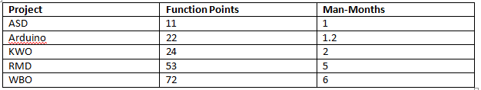
Arduino WSN ZigBee
Chart 2

Slide 10
Arduino WSN ZigBee
References
Mc Connell, Rapid Development, Microsoft Press, 1996
C. Jones, Applied Software Measurement, 1991, McGraw Hill
D. Garmus and D. Herron, Measuring the Software Process, Prentice Hall, 1996
Helmut Balzert, Lehrbuch der Software-Technik, Spektrum Akademischer Verlag 2001

Slide 11
Arduino WSN ZigBee

